Slide 1
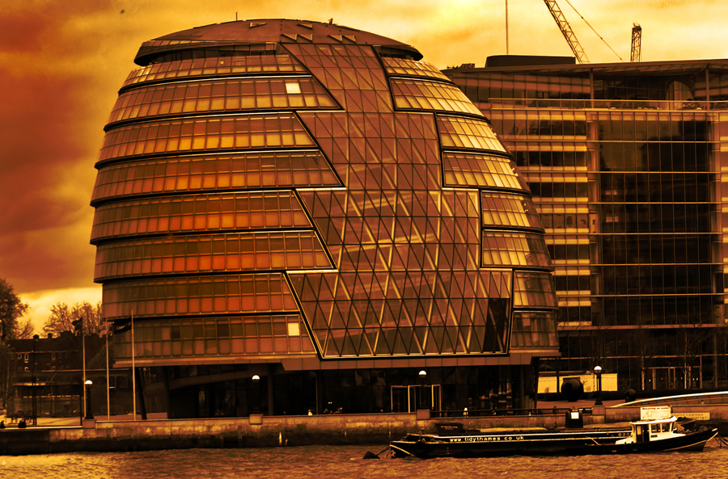
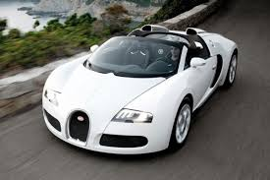
England
Donovan 4 B

Slide 2
MAP OF THE WORLD

Slide 3
MAP OF ENGLAND

Slide 4
Queen of England
I am happy!

Slide 5
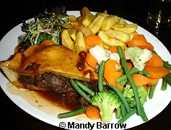
Typical food
Steak and kidney pie with chips and vegetables

Slide 6
Capital city
London

Slide 7
Big cities
Liverpool
Manchester

Slide 8
Flag of england

Slide 9
A monument in England

Slide 10
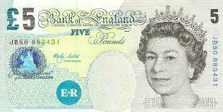
Money in England

Slide 11
Famous people

