Slide 1
canada
Ayoub 4°B

Slide 2
World map

Slide 3
Map of Canada

Slide 4
Flag of Canada

Slide 5
Emblem of Canda

Slide 6
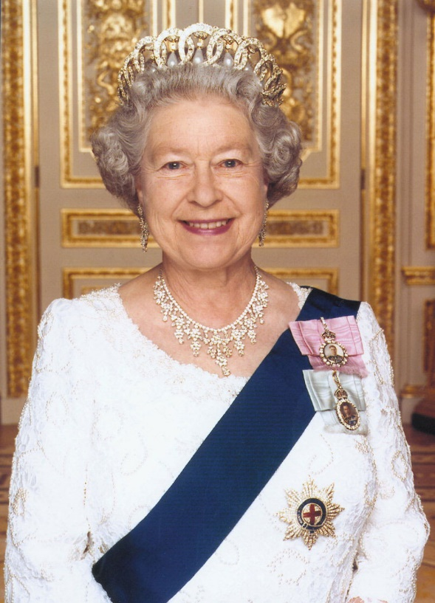
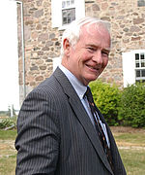
Heads of state: Queen Elizabeth and the Governor General, David Lloyd Johnston.

Slide 7
Currency: Canadian dollar

Slide 8
Scenery

Slide 9
Capital city: Otawa

Slide 10
Largest cities: Montréal,Quebec,Toronto

Slide 11
Famous monuments: Absolute Tower

Slide 12
Typical food: poutine

