Slide 1
THANKSGIVING
HISTORY AND FAMILY TRADITION
Marion Méranger-Galtier

Slide 2
I. The history of Thanksgiving.

Slide 3
In the past, America was inhabited by Indian tribes (native Americans).
The Wampanoags
lived there
for over
12000 years.

Slide 4
In 1620, a hundred English protestants (Puritans) crossed the ocean from England to America to start a new life. They are often called Pilgrims or Founding Fathers in the USA.
They were fleeing
King James I for religious reasons.

Slide 5
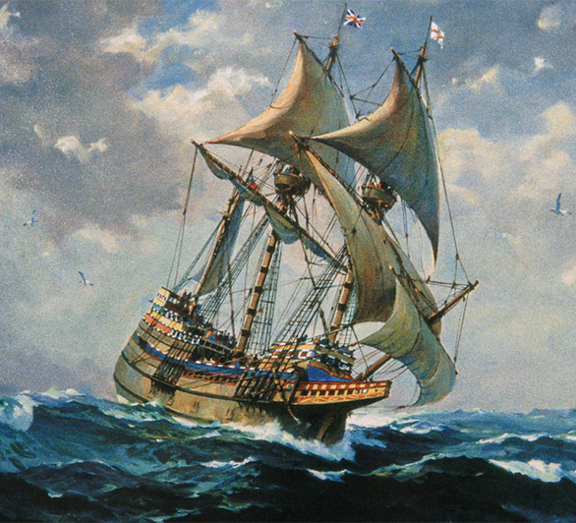
They sailed on a ship called the Mayflower.

Slide 6
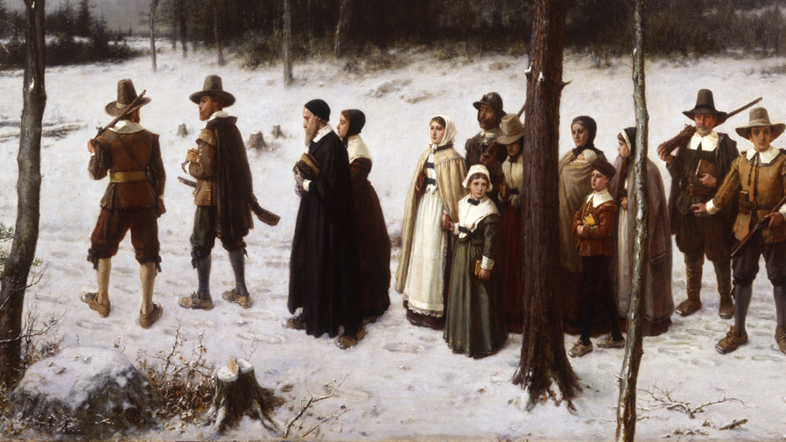
The trip was long and difficult, they arrived too far north, they had no houses and they were not well equipped. The first winter was very cold and many people died.

Slide 7
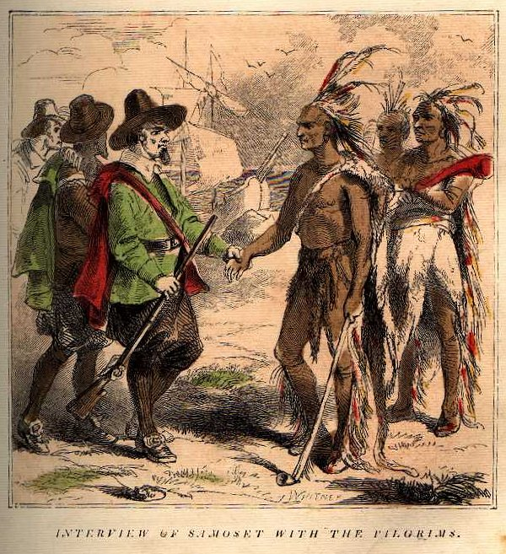
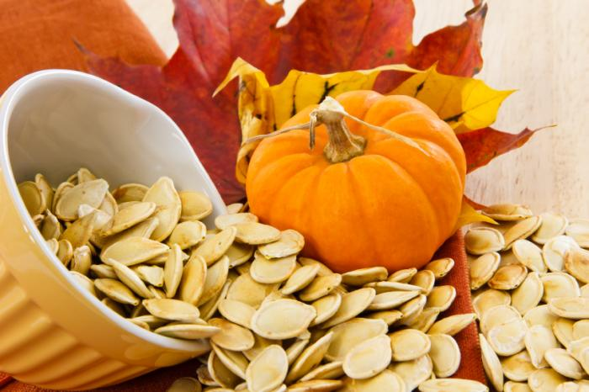
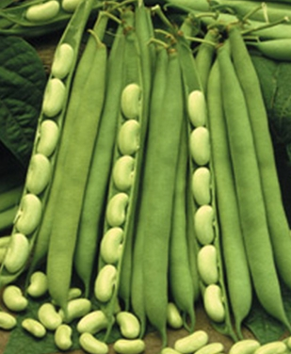
Some Wampanoag Indians came and helped them. They showed them how to survive and they gave them seeds.
pumpkin seeds
bean seeds
corn seeds

Slide 8
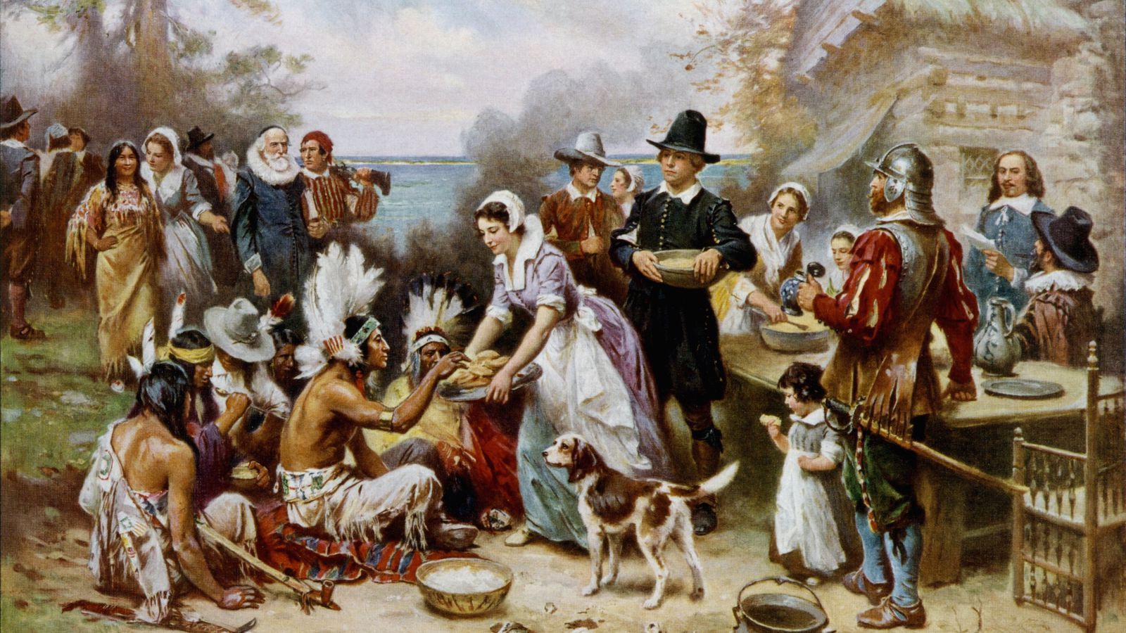
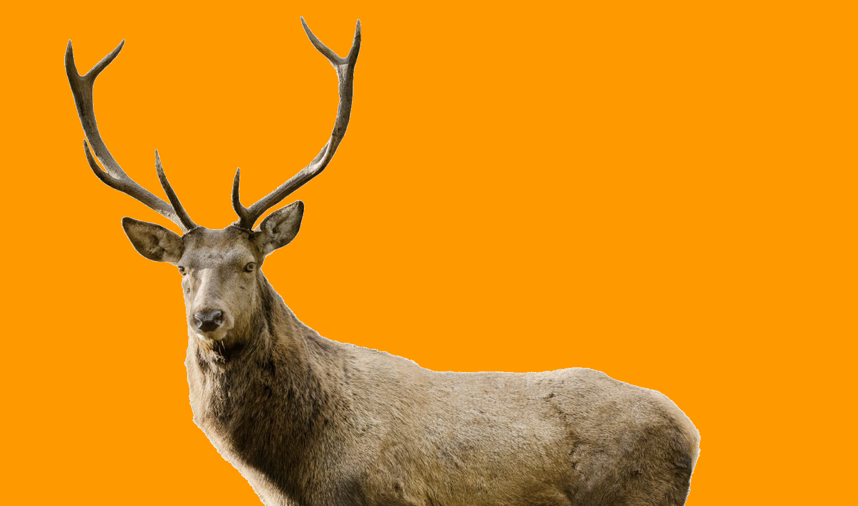
The following year, in October 1621, the Puritans wanted to celebrate their survival. They had a 3-day feast with the Indians where they prayed God and served a lot of food from their harvest. The Indians brought deers to eat.

Slide 9
The friendship between the Puritans and the Indians only lasted for one generation. After that, more white people colonized America, taking the Indians’ land and killing many of them in war or by bringing new diseases from Europe.
Historians estimate that in the times of Christopher Colombus there were 10 million indigenous people (native Americans) living in what is now U.S. territory.
By 1900, the number was less than 300,000 people.

Slide 10
II. The modern tradition of Thanksgiving.

Slide 11
Thanksgiving is celebrated on the 4th Thursday of November. Thanksgiving decorations use the colors and plants of fall.
scented candles
pumpkins
apples
chestnuts
grapes
fall leaves
pine cones

Slide 12
Thanksgiving is a moment to think of all the good things we can enjoy in our lives, all the things that make our families and friends happy.

Slide 13
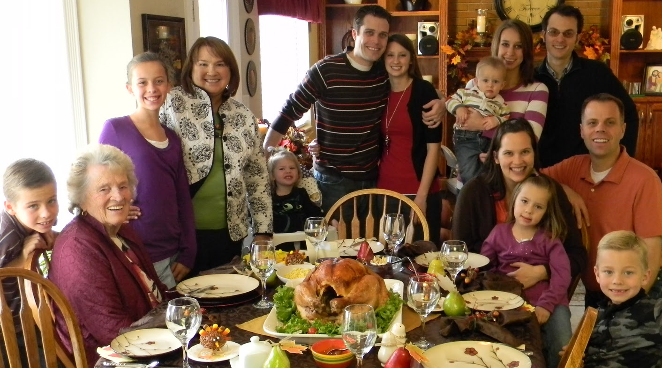
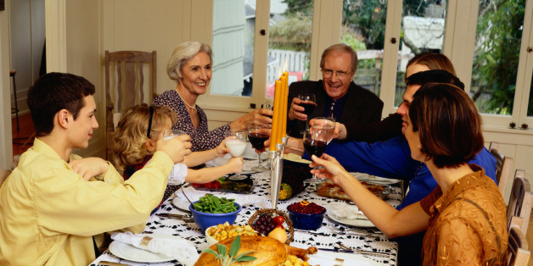
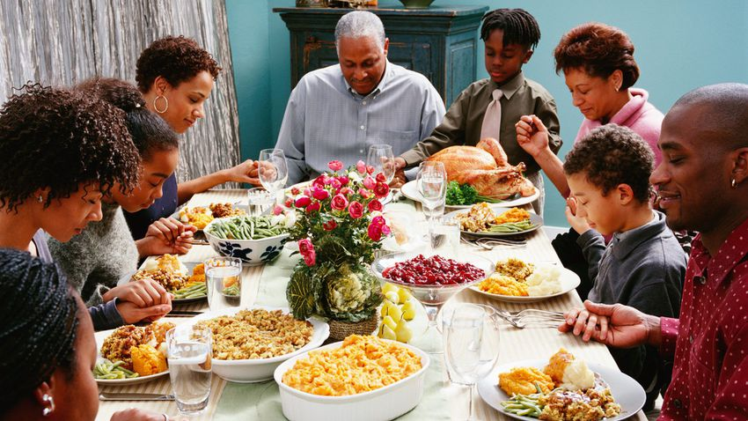
At Thanksgiving, families come together for a big meal.

Slide 14
There is a lof of food at Thanksgiving dinner!

Slide 15
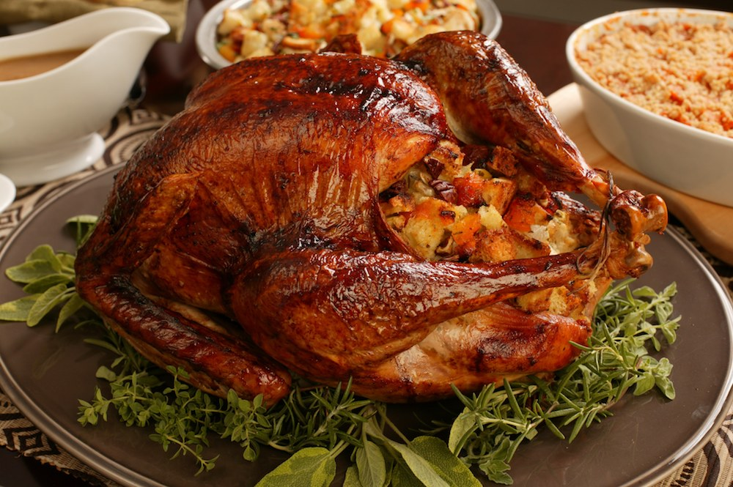
Meat…
Honey glazed ham
stuffed roast turkey

Slide 16
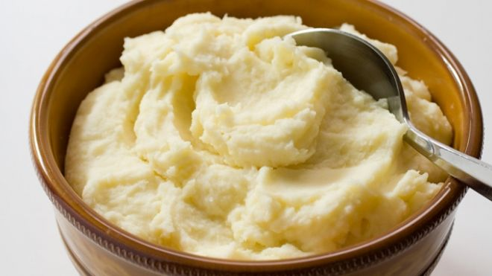
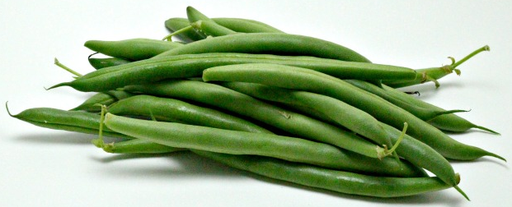
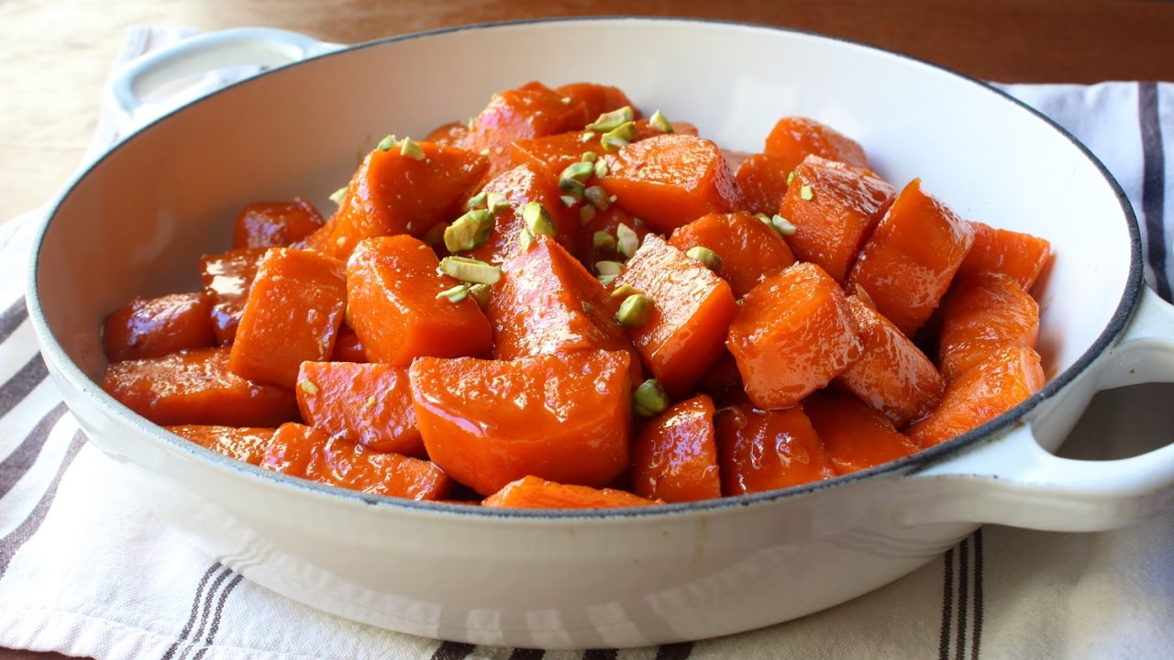
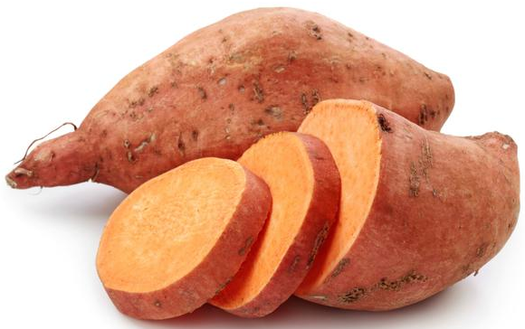
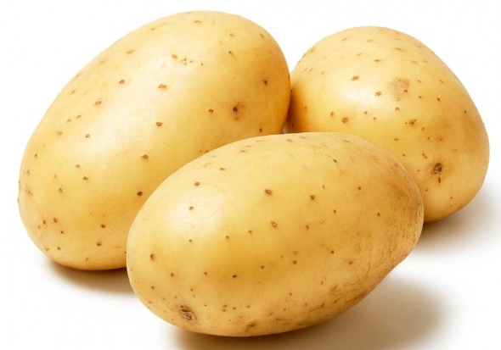
…side dishes…
green beans casserole
mashed potatoes
glazed yams

Slide 17
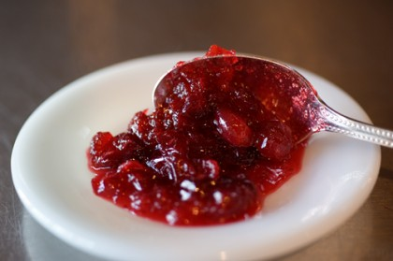
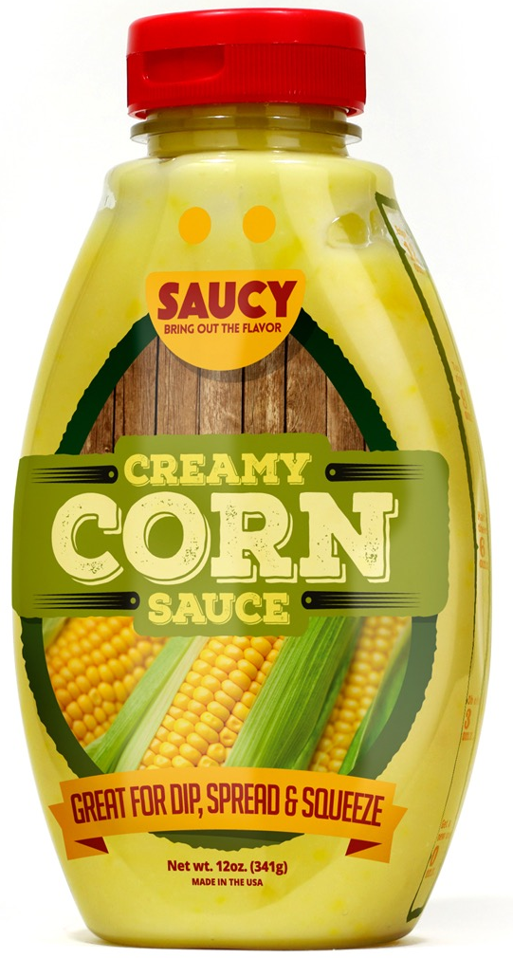
…sauces…
gravy
cranberry sauce
corn sauce

Slide 18
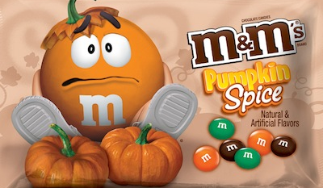
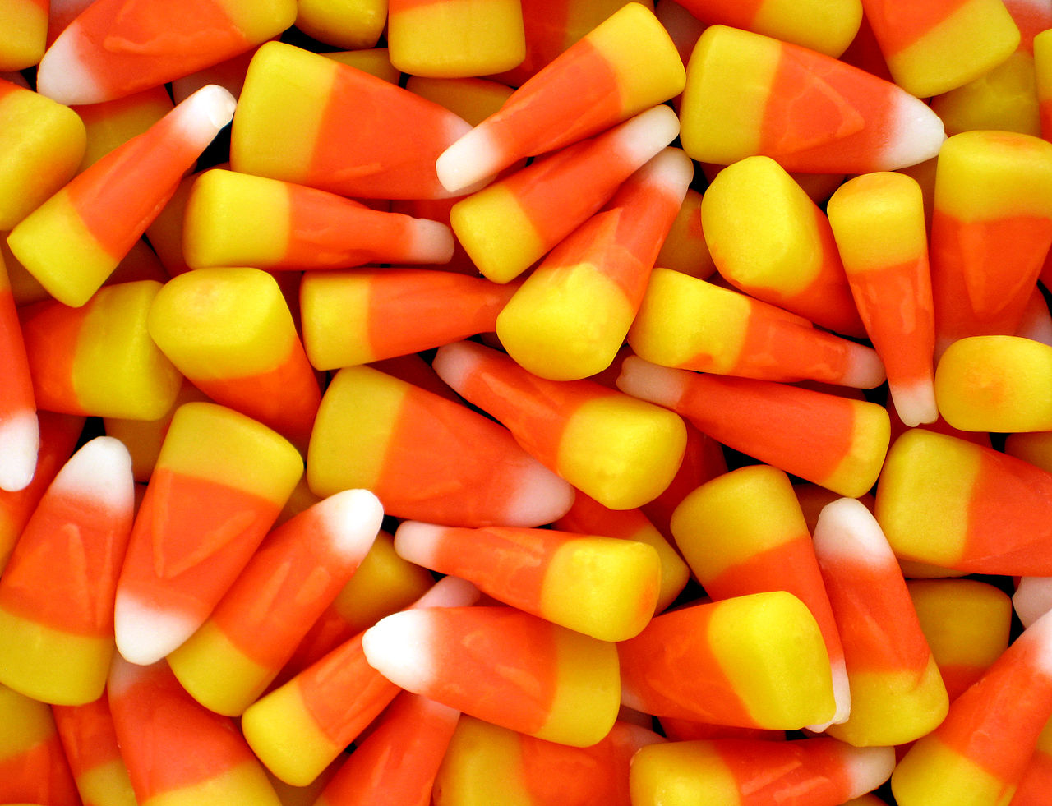
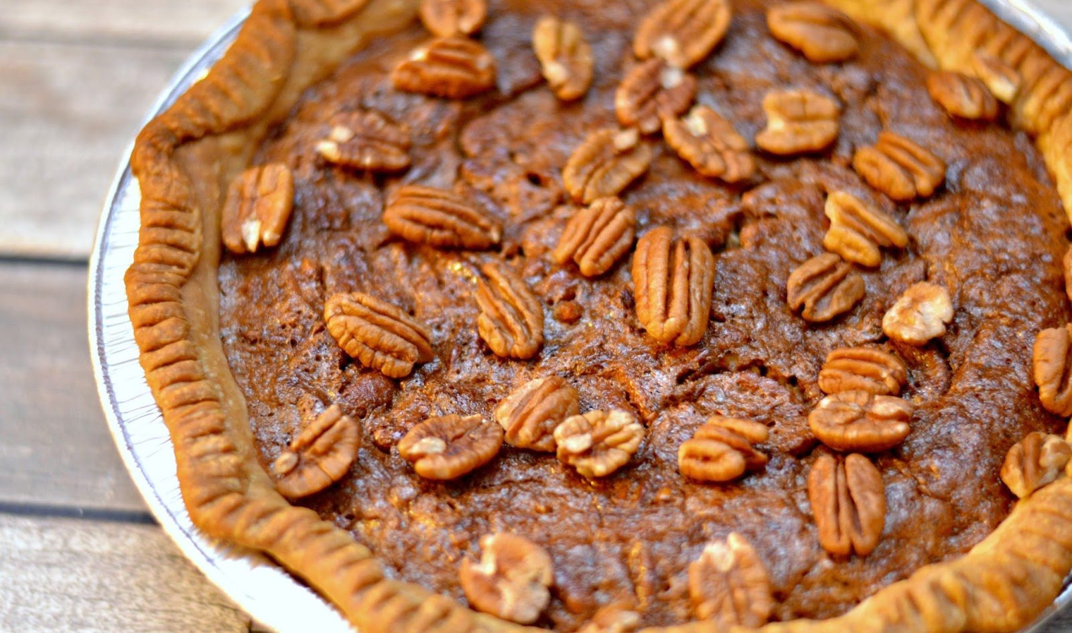
…dessert and candy!
pumpkin spice M&Ms
candy corn
pumpkin pie
pecan pie

Slide 19
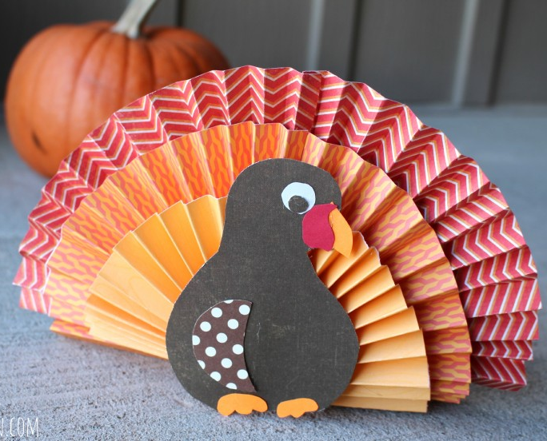
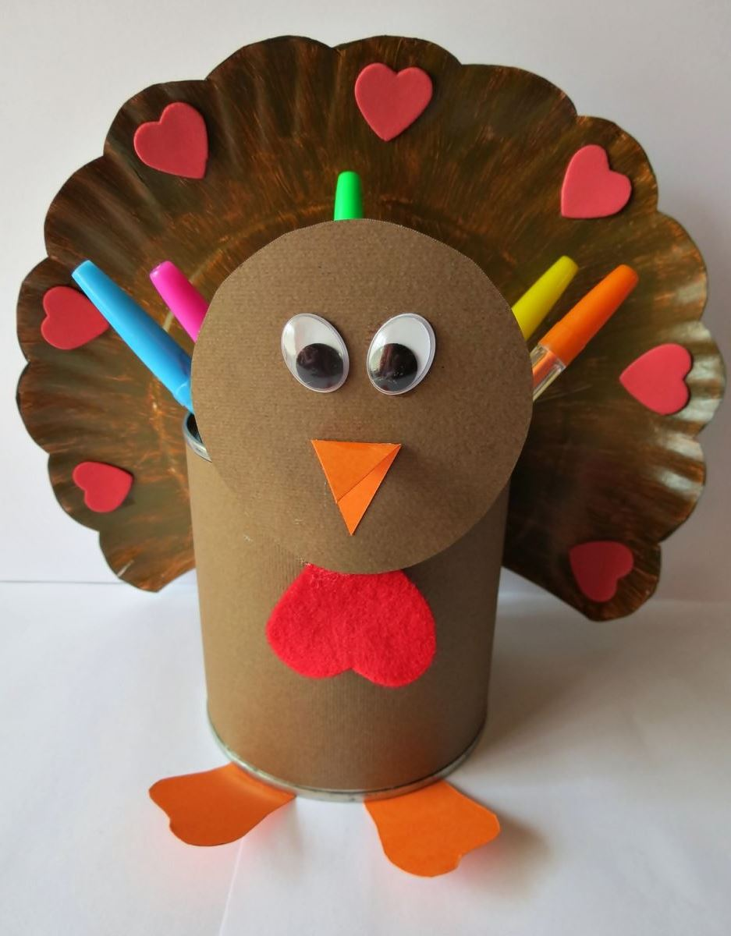
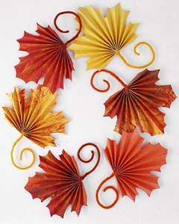
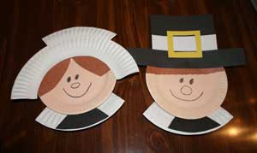
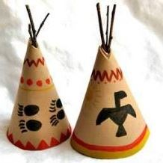
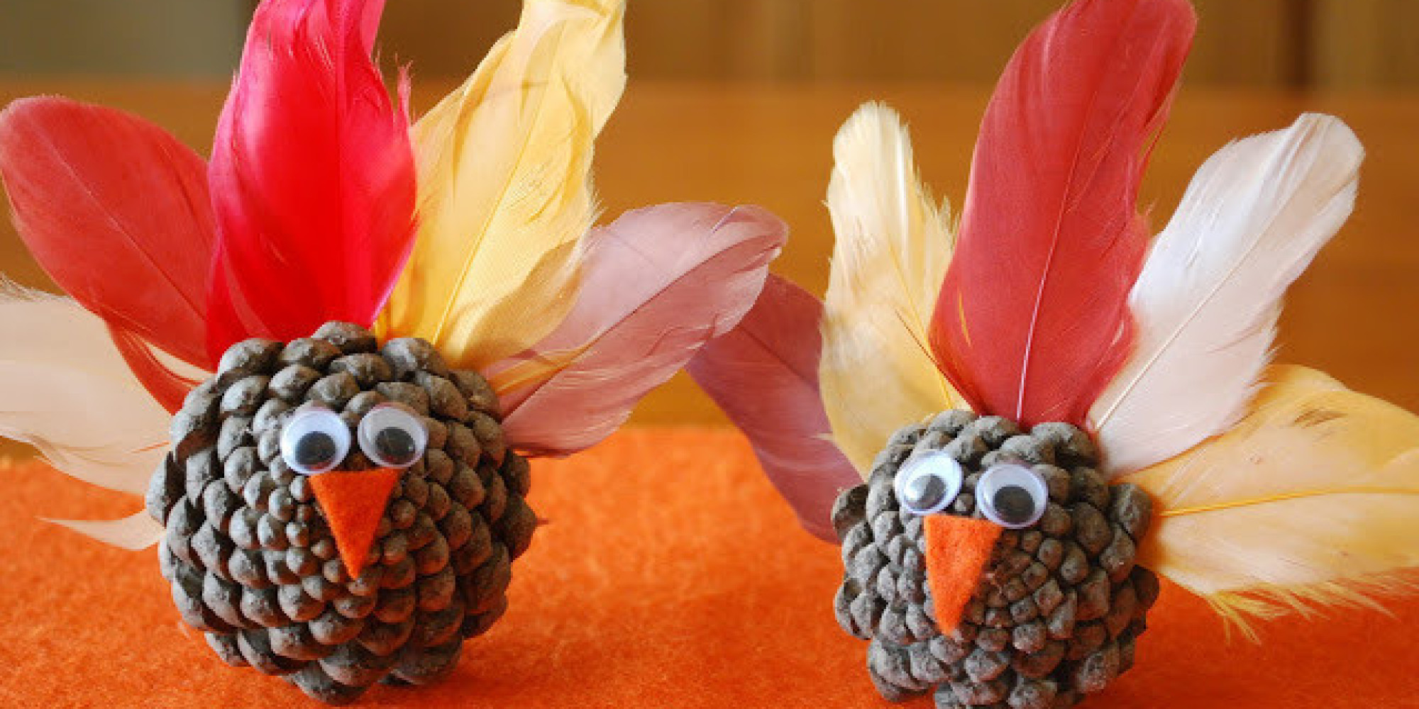
Children make arts and crafts for Thanksgiving, at school and at home.

Slide 20
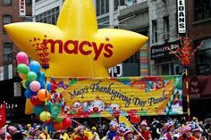
Many American cities have a big parade for Thanksgiving. Manhattan’s parade is famous for its giant floating balloons.

Slide 21
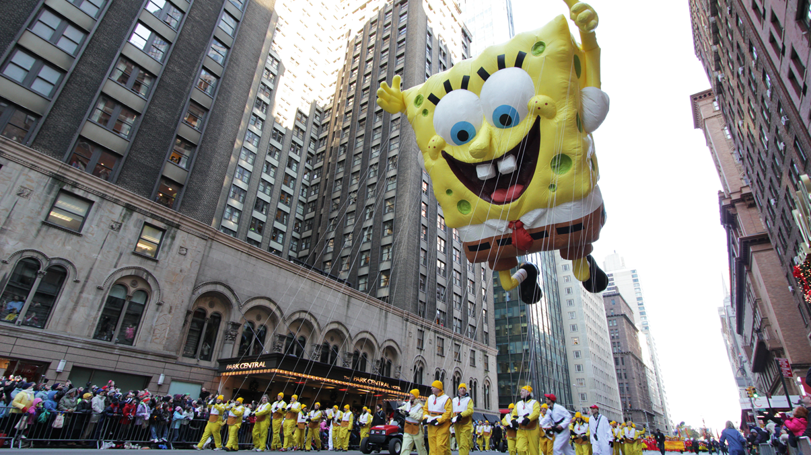

Slide 22
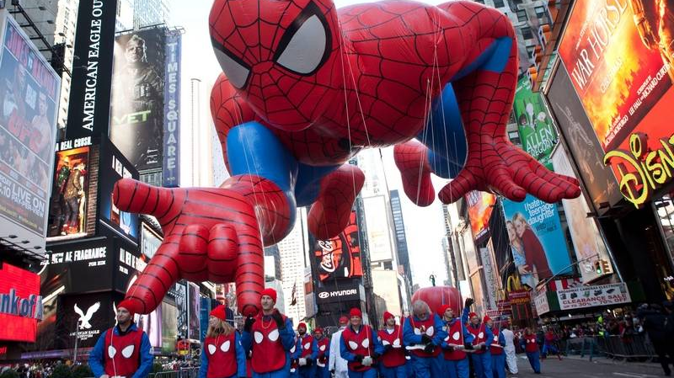

Slide 23
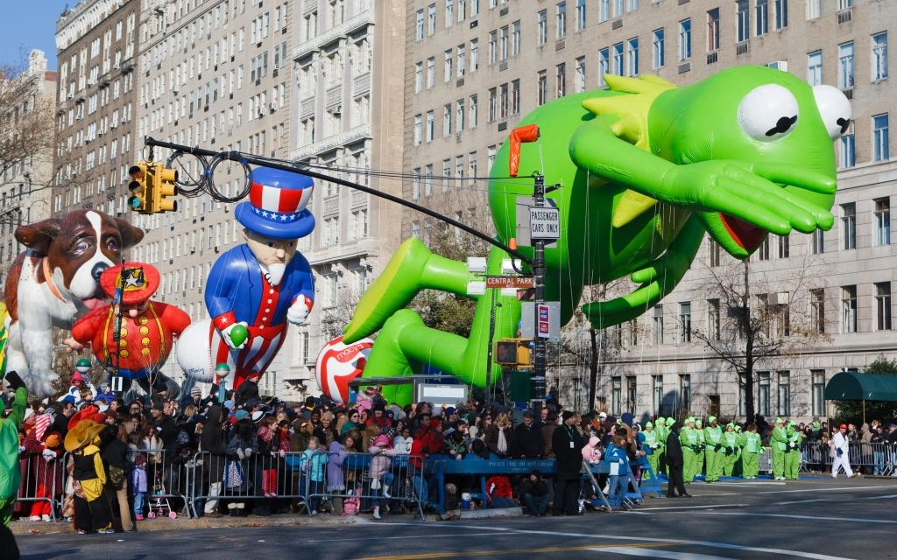

Slide 24
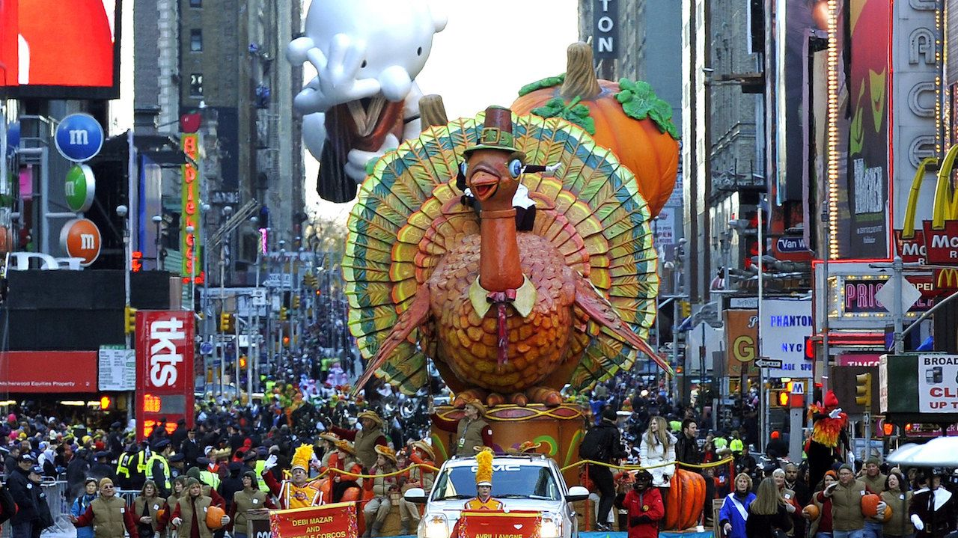

Slide 25
To most Americans, Thankskgiving is a well-loved family tradition. But to some, it is a sad reminder of the brutal massacre of the native Americans and of the racism and oppression their descendants still have to live with.

